Slide 1
Analytical Instrumentation
Prof. Sujit M. Deokar,
Department of Instrumentation Engg.
Vishwakarma Institute of Technology, Pune
Lecture 06 :
Ultraviolet and Visible Spectrophotometry – 1
Theoretical Aspects

Slide 2
Recap
Transmission of Radiation
Dispersion
Diffraction
Reflection & Refraction
Snell’s Law
Polarization of Light
Prism as dispersive device
Monochromatic Slit

Slide 3
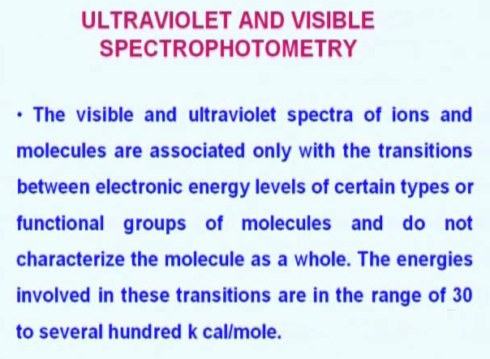
Introduction

Slide 4
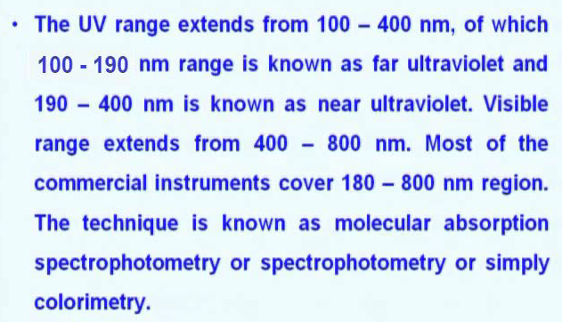
Introduction

Slide 5
Quantum Theory
Energy state of atom or molecule is well defined.
For any change from one state to another it requires energy.
Now specific change in a state will required specific amount of energy. This is provided by photons of specific energy having specific frequency.
For given specific frequency this photon can be absorbed.
Number of photons absorbed will also define number of molecules or atoms.
This is Quantitative & Qualitative analysis.

Slide 6
Quantum Theory
The absorption of radiation involves basically transfer of energy to the medium and this process is a specific phenomenon related to the characteristic molecular structure.
For a given excitation process, a molecule absorbs a discrete quantity of energy corresponding to only one frequency which should give rise to one absorption line.
However, since a group of same molecules exist in a number of vibration and rotational energy levels, state corresponding to energy levels in which the electrons are populated, a series of absorption peak or band is obtained.

Slide 7
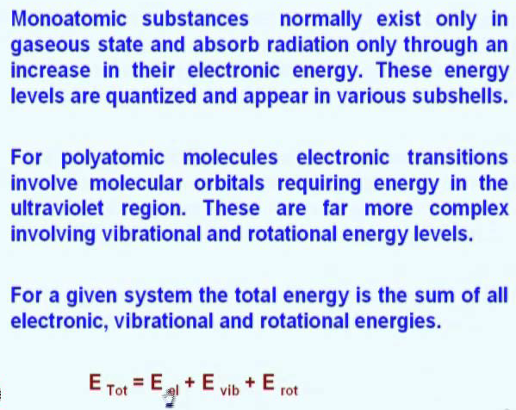
Quantum Theory

Slide 8
Morse Potential function
Just like the atoms, electrons in the molecules can also get excited by absorption of quantized energy in the ultraviolet region atoms.
Molecules get excited, but in the molecules electrons get excited, molecular electronic energies are represented by a Morse Potential function in which the potential energy of each electronic state is plotted as a function of inter nuclear distance, that is you plot a inter nuclear distance versus potential energy.

Slide 9
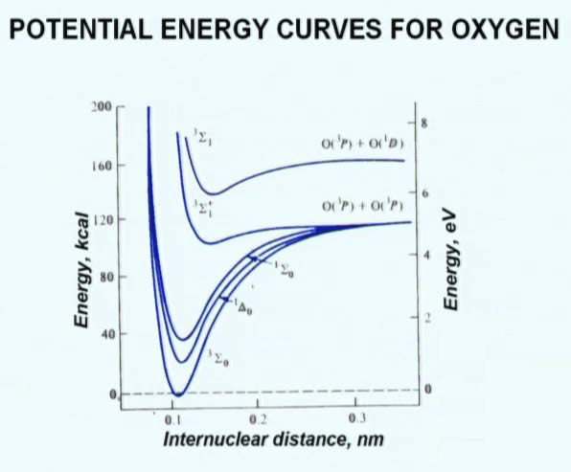
Morse Potential function

Slide 10
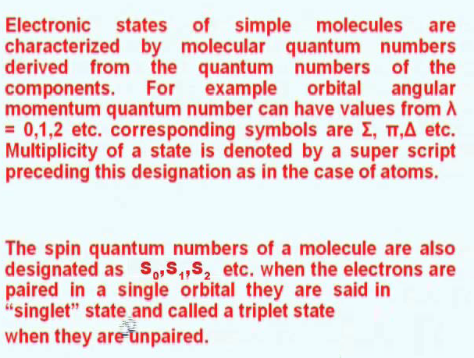

Slide 11
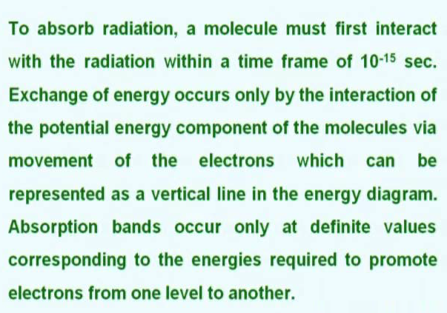

Slide 12
